Slide 1

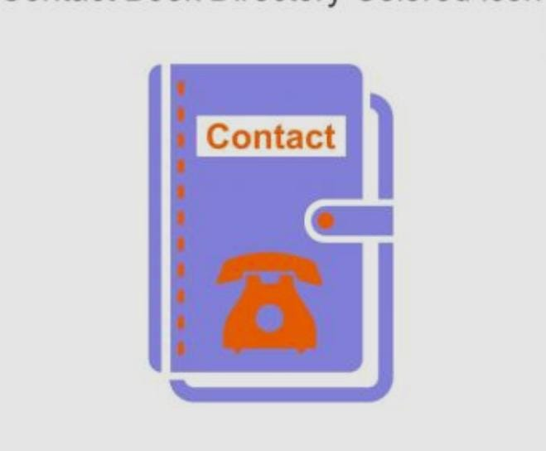
PROJECT:
TELEPHONE CONTACT BOOK
PRESENTED BY:
M.Sai Jagruthi (25A31A05BV
P.Thaswika (25A31A05CC)
Y.S.Abhinay (25A31A05DU)
S.Vikram (25A31A05DO)

Slide 2
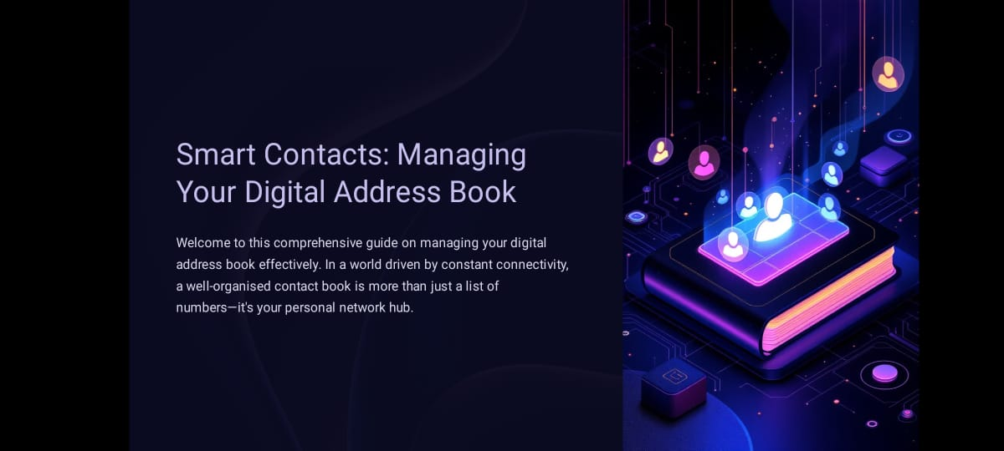

Slide 3
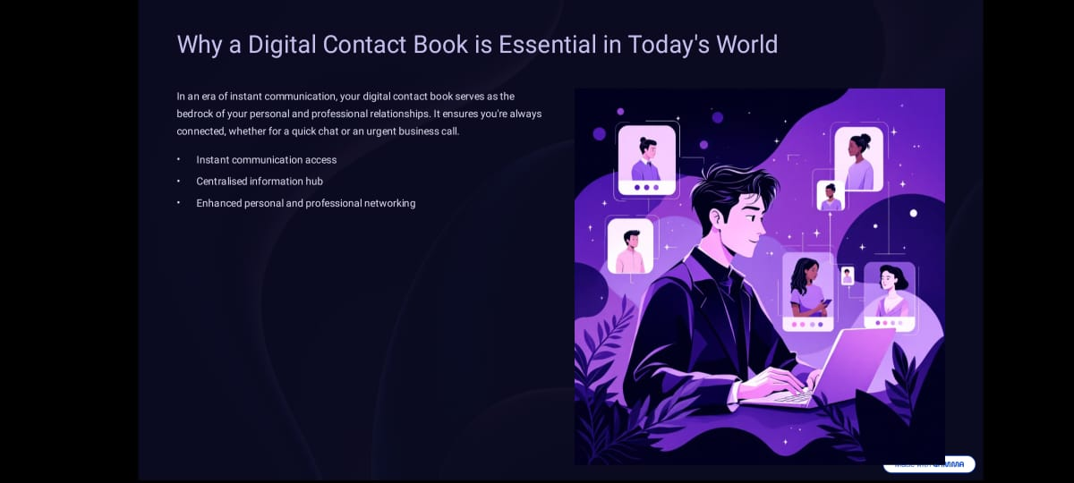

Slide 4
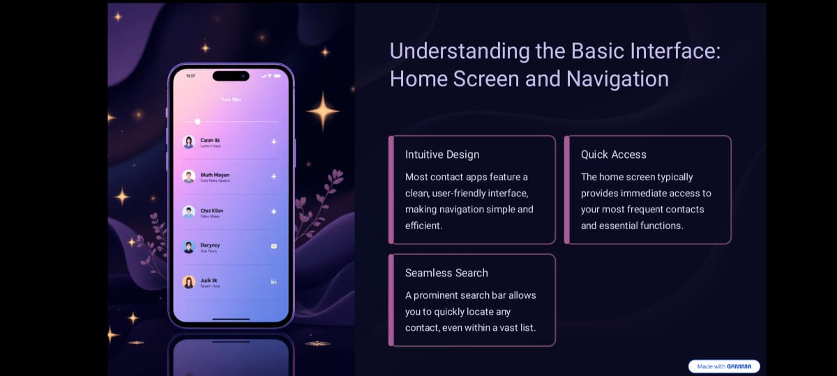

Slide 5
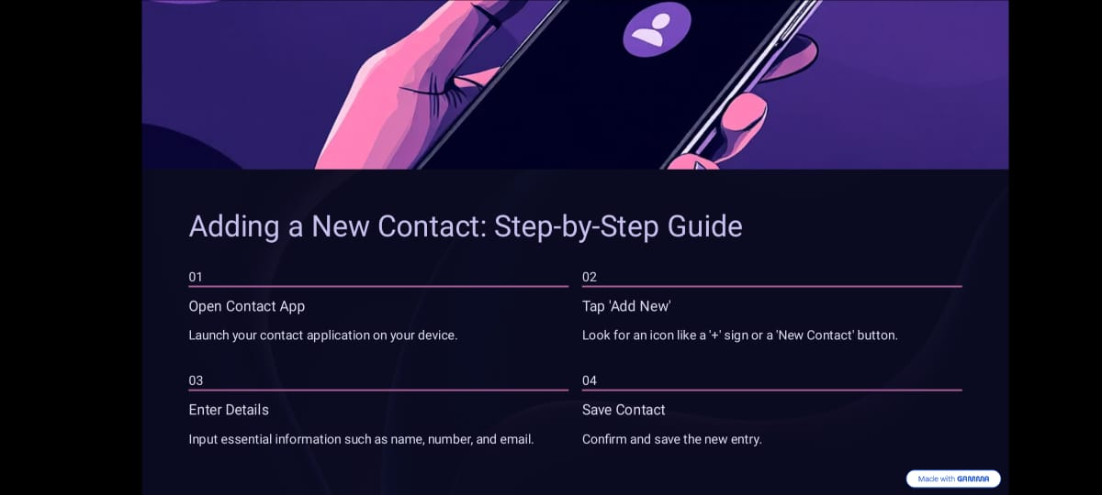

Slide 6
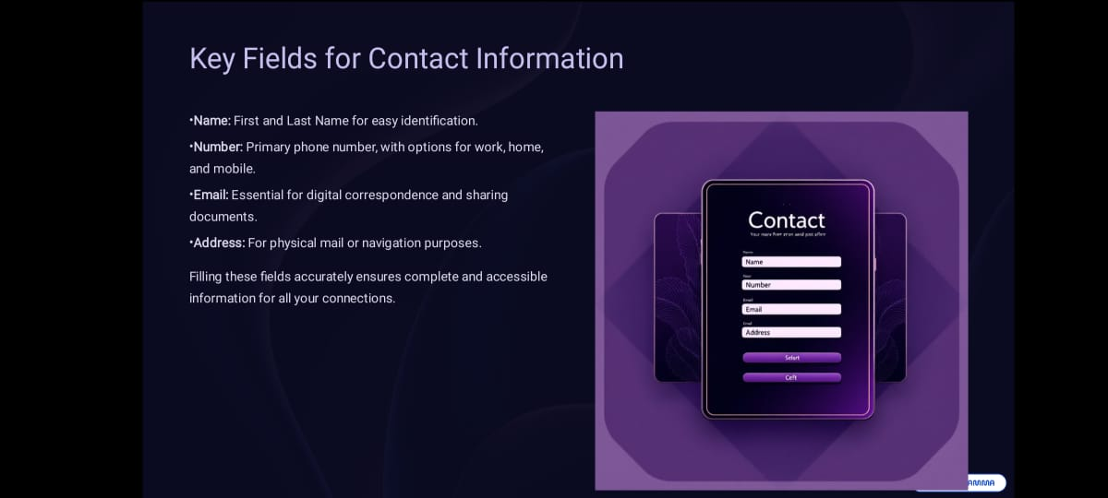

Slide 7
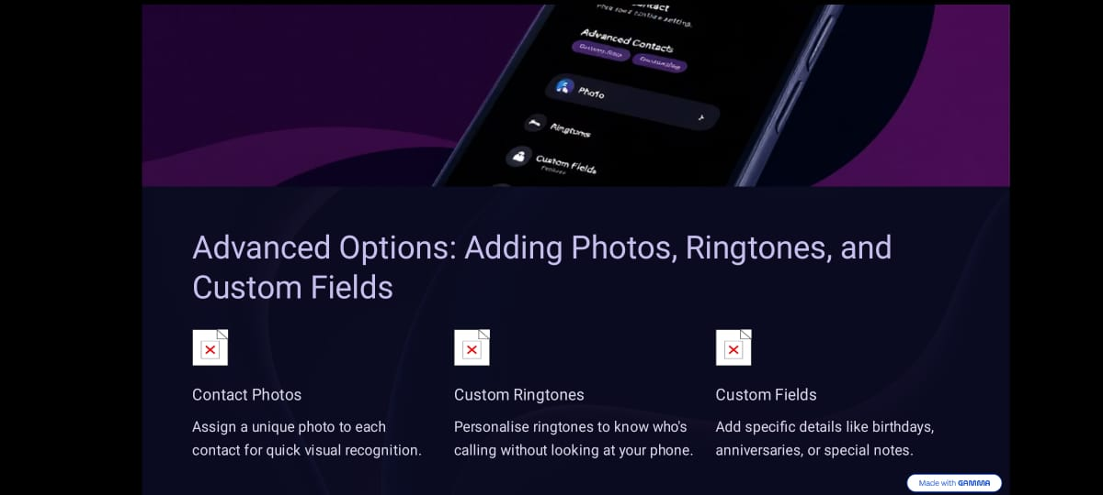

Slide 8
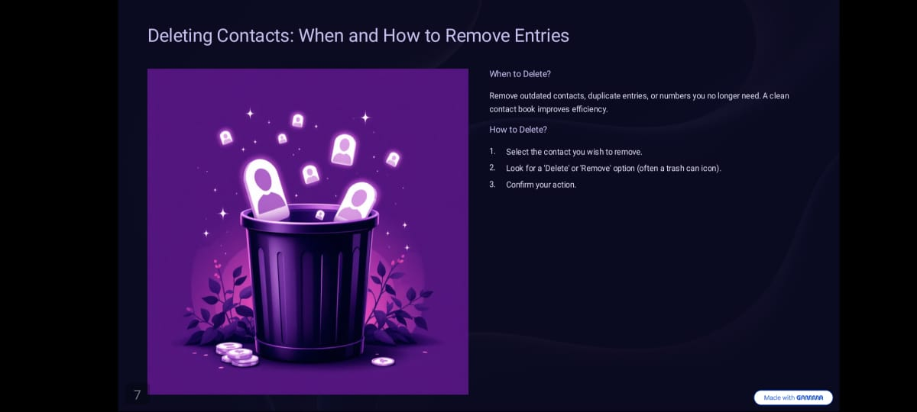

Slide 9
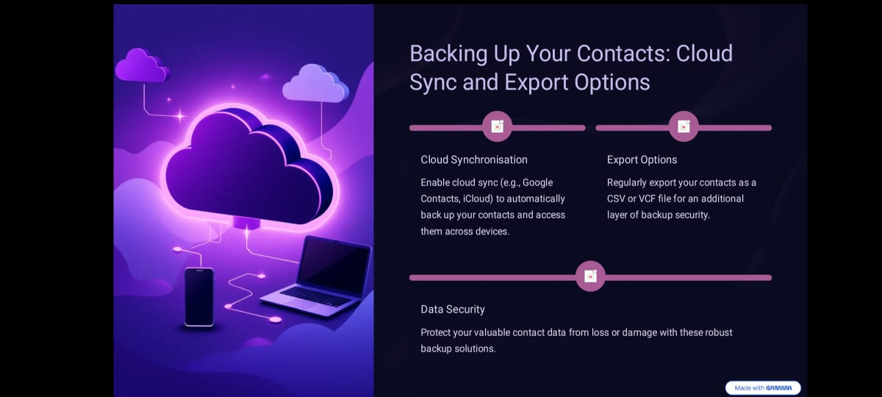

Slide 10
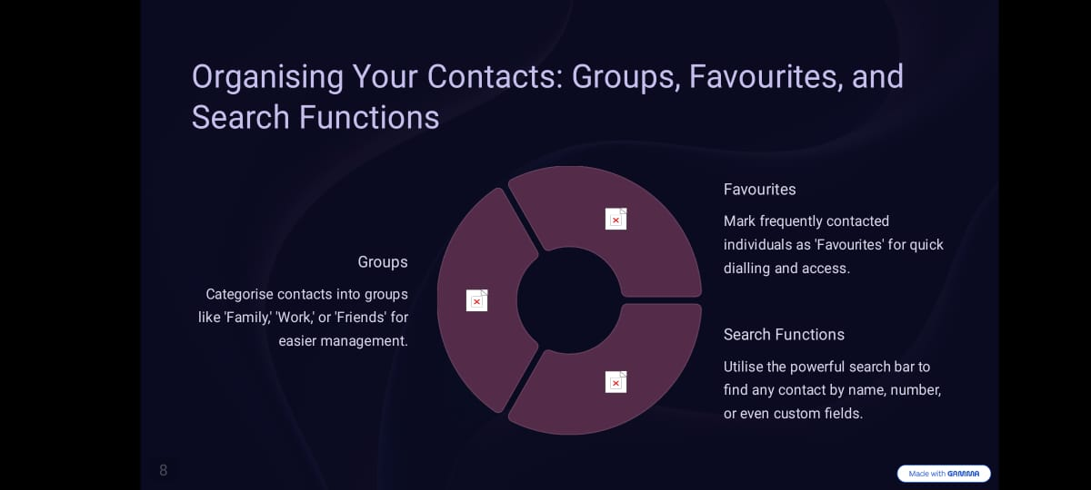

Slide 11
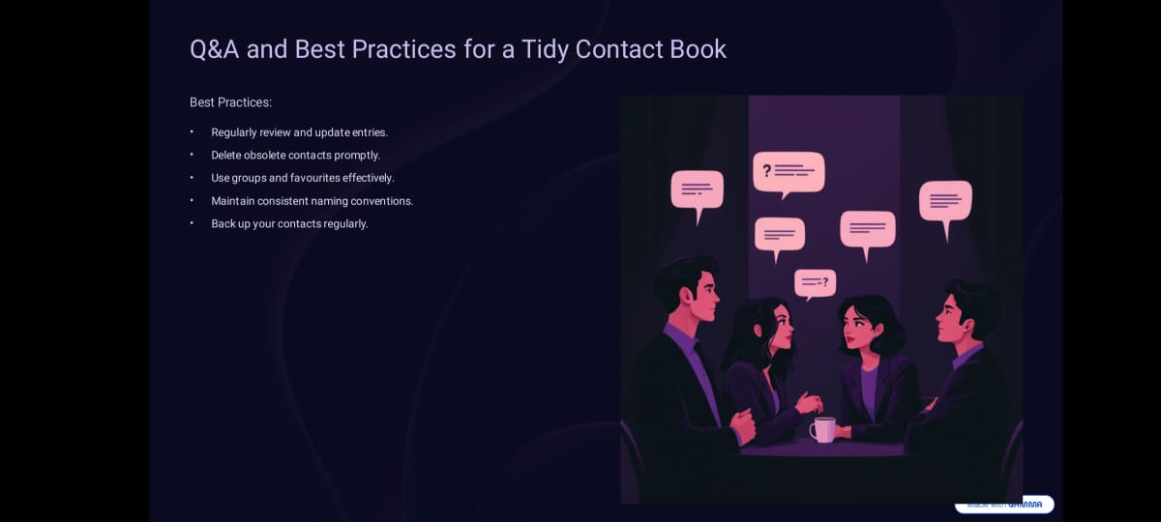

Slide 12
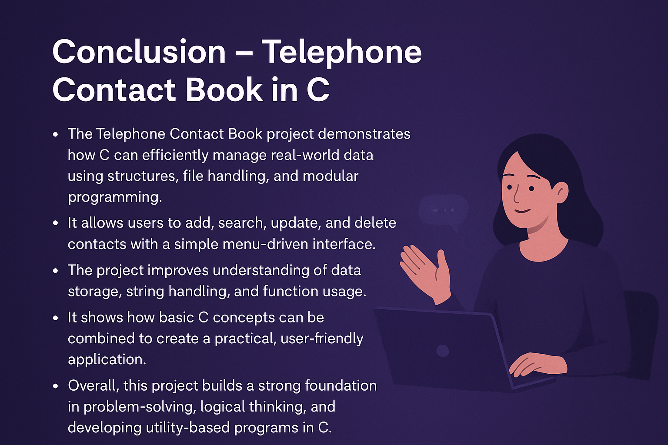

Slide 13


